Slide 1



Quantifying black carbon in urban soil in Phoenix
Marie Nahlikª, Alex Hamiltonª, Hilairy E. Hartnett ^{a, b}
ª Department of Chemistry and Biochemistry, Arizona State University, Box 871604, Tempe, AZ 85287, USA. ^{b} School of Earth and Space Exploration, Arizona State University, Box 871404, Tempe, AZ 85287, USA
Arizona Space Grant Statewide Symposium
April 21, 2012

Slide 2
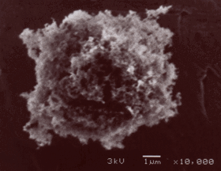
Soot Black Carbon (BC)
Black carbon (BC) is a product of incomplete combustion of fossil fuels and biomass
Appears to be found everywhere, from terrestrial and aquatic ecosystems to the atmosphere
0.05-0.27 Gt/year produced
Soot BC: secondary formation product of the hot gases produced in flames
Soot BC is highly condensed, refractory, non-reactive type of BC
Soot particle

Slide 3
Health Effects of BC
Respiratory effects: traffic-related pollutants, including BC, have been associated with respiratory problems
Cardiovascular effects: air pollutants, including BC, are associated with arrhythmia
Particulate matter, including BC, has been found to cause pulmonary inflammation, which can lead to lung diseases such as asthma and chronic obstructive pulmonary disease
Knowing BC concentrations serves a potentially important function in understanding environmental conditions and protecting human health

Slide 4
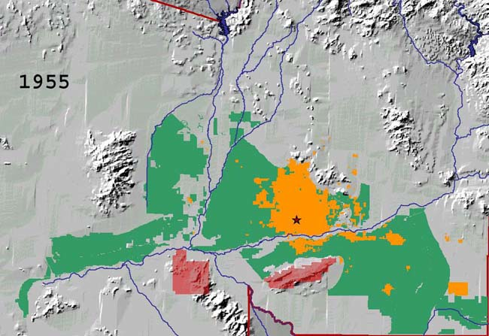
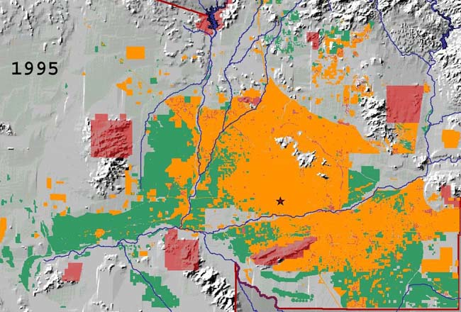
Phoenix, AZ
Phoenix has low soil carbon content but a high percentage of soot BC, so BC/OC is high (~31%)
Urban soils have the highest concentration of BC, agricultural soils have an intermediate amount, and desert soils have the lowest BC concentration
Yellow represents urban area, green represents agricultural land, and red represents parks.

Slide 5
Goal of the Study
To examine patterns of BC concentration in top soil across the Phoenix metropolitan area in greater detail
Since urban soil has been found to contain the most BC and also had large variation in [BC], this study attempted to distinguish which types of urban soil had the highest BC concentrations
To see if there were relationships between BC content and land use practices

Slide 6
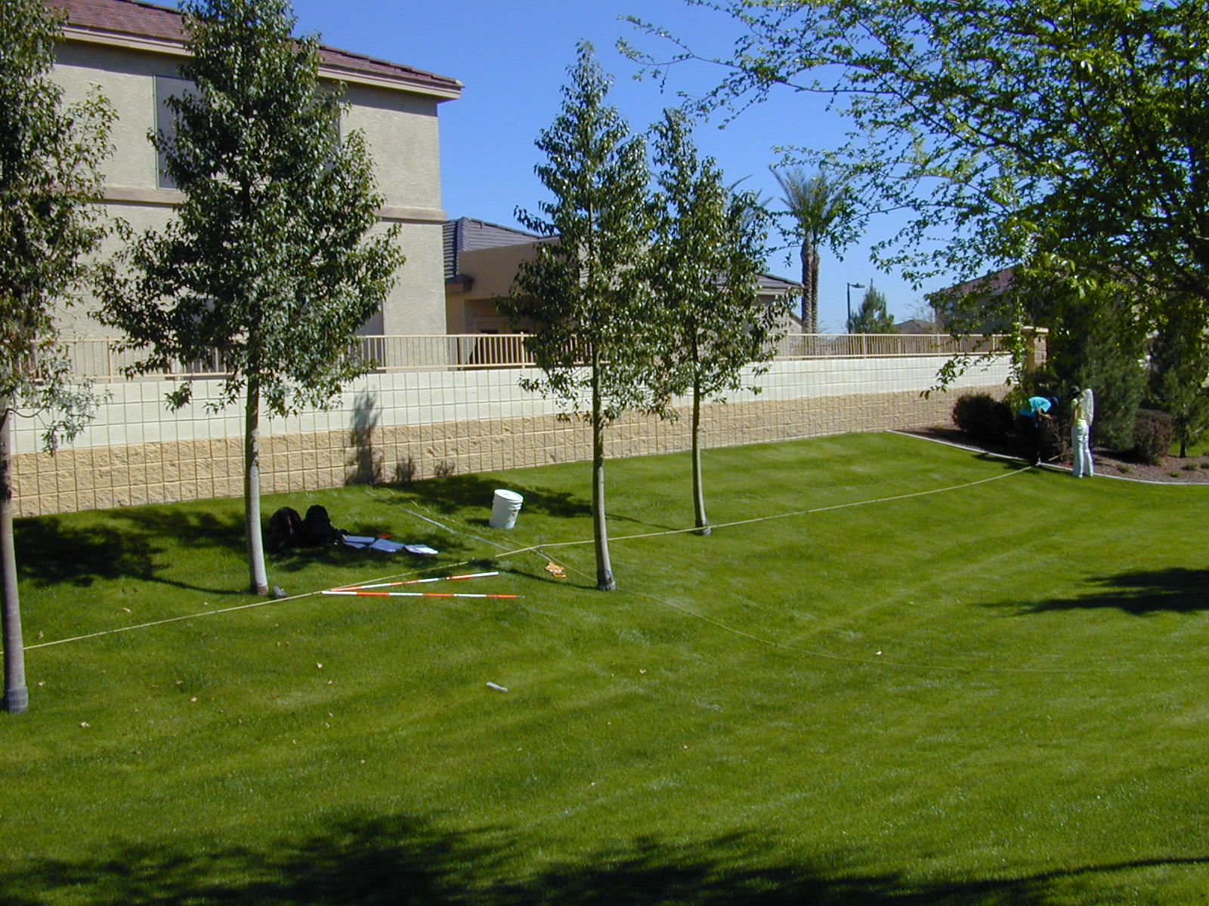
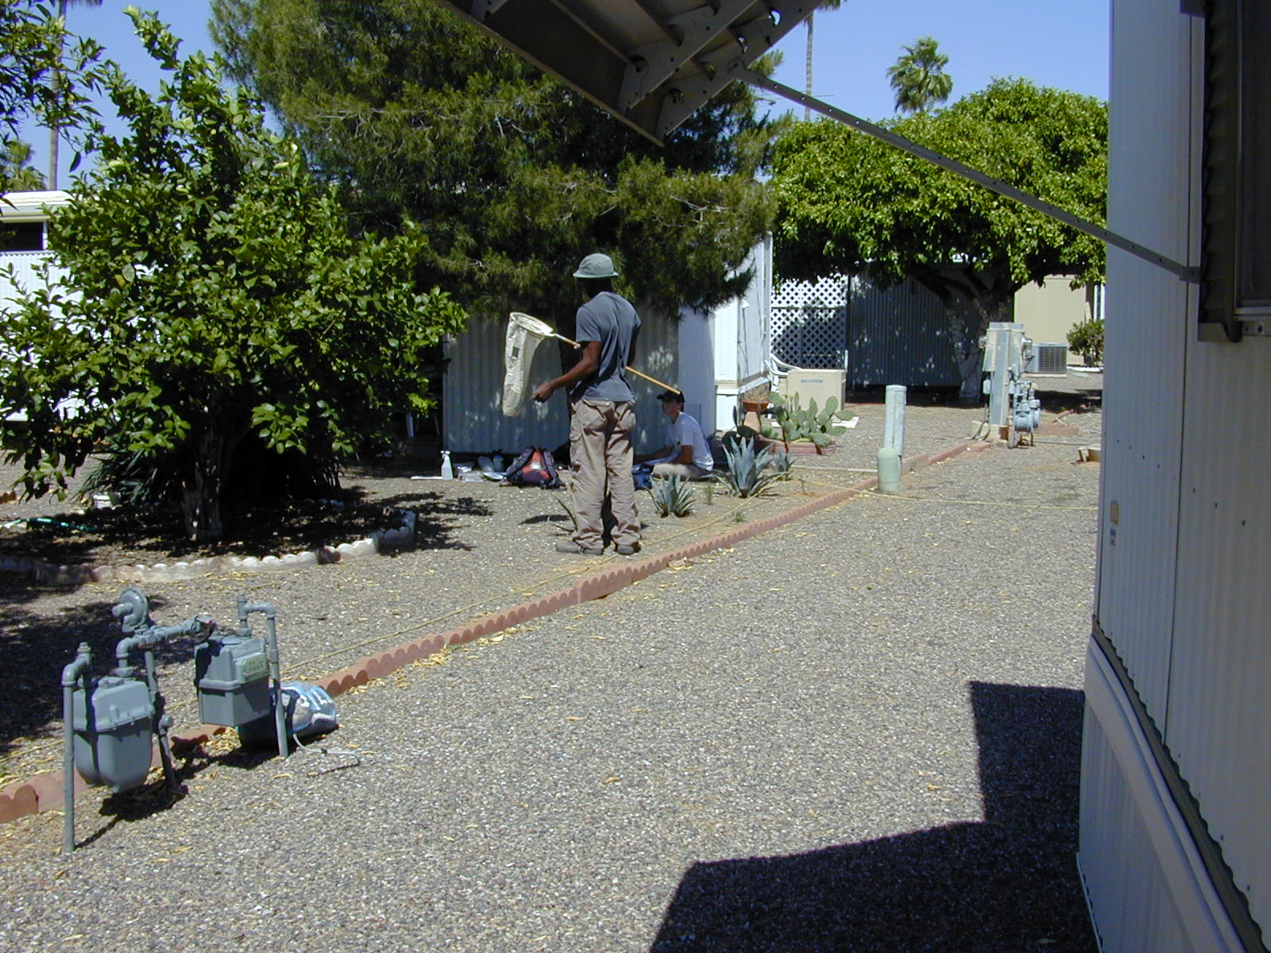
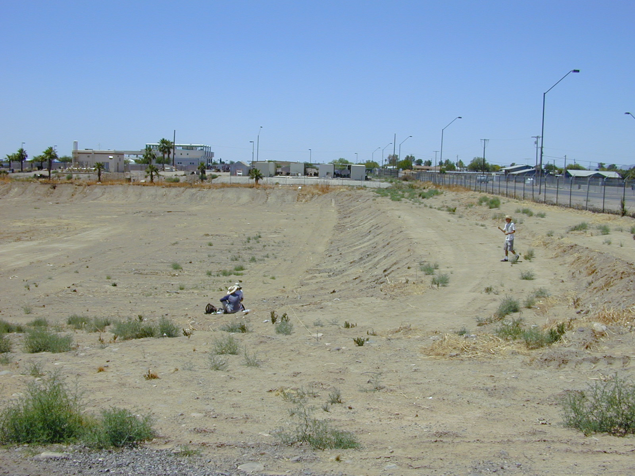
Mesic site (AE191)
Xeric site (AB181)
Institutional site (O171)

Slide 7
Methods: Soil Collection
The Central Arizona-Phoenix Long-Term Ecological Research (CAP LTER) project collects approximately 200 samples from randomly selected sites in the Phoenix area every five years. This study used soils from 2010.
Site = 30 m x 30 m
Soil cores were collected from the top 2’’ at each of the cardinal points

Slide 8
Methods: Chemo-thermo oxidation
Chemo-thermo oxidation (CTO375): removes all forms of carbon besides BC
Dry samples
12-16 hours, 20°C
Grind samples
to <1 mm
Weigh samples
~18 mg in silver capsules, which go in a Teflon^{tm} 25-well tray
Add HCl (4 M) twice *removes carbonate from the samples
Bake samples 375°C for 24 hrs.
*removes labile OC
Transfer samples to aluminum tray
Dry samples
Elemental analysis and isotope ratio mass spectrometry (EA-IRMS): used to determine [BC]

Slide 9
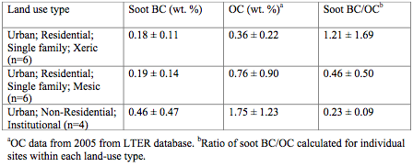
Results
BC concentrations ranged from 0.07 to 1.19 wt. % based on dry soil mass
Average: 0.26 wt. % BC

Slide 10
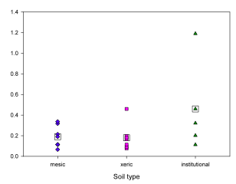
Concentration of soot BC (wt. %) for three land use types
Soot BC (wt. %%)
Blue diamonds represent mesic sites, pink squares represent xeric sites, and green triangles represent institutional sites. Squares show the averages for each land use.

Slide 11
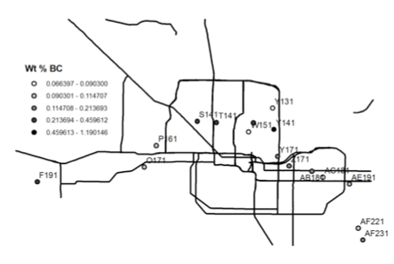
Map of Phoenix area
Roads (solid lines), sample sites (circles), and soot BC concentrations (circle shading) shown

Slide 12
Conclusion
Since urban soils from institutional sites contain statistically higher concentrations of soot BC than those from residential areas, this suggests that human activity is a source of BC in the central AZ region. Data from more sites is necessary.
The lack of difference in BC concentration between xeric and mesic soils suggests that landscaping practices play little to no role in determining soot BC concentration in soil.
No pattern was detected between [soot BC] and distance from sites to the nearest major roads.
The relationships between these variables or the lack thereof may play an important role in determining sources of black carbon.

Slide 13
Health Implications
The results showing that residential areas have lower BC concentrations than institutional areas is positive.
Implications for people who spend a significant amount of time in or near institutional areas- those who work there and those who live in neighboring residential areas
Because BC has already been linked to adverse health effects, gaining a clearer understanding of its distribution as well as identifying its sources have important implications for health in the population.
Further research may focus on who works or lives near institutional areas as a way to understand and address health disparities

Slide 14
Thank you This work was supported by the NASA Space Grant program and by NSF Grant No. DEB-0423704: Central Arizona−Phoenix Long-Term Ecological Research (CAP-LTER).

Slide 15
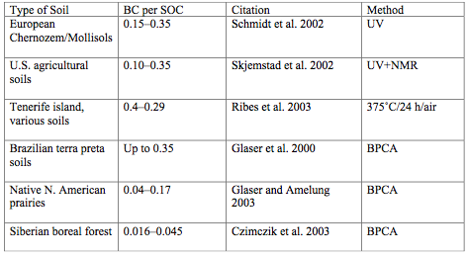
BC/OC in other soils

Slide 16
BC degradation
Oxidation degrades BC by mineralizing it to CO₂ or changing it to other organic forms that contain more O
Adsorption of non-BC materials onto BC surfaces reduces the surface area exposed to oxygen and slows down oxidation
Soil type, climate, biota, and land use practices all affect whether black carbon accumulates or is lost in soils
When exposed to low levels of ozone, BC particles undergo rapid surface hydroxylation and subsequent solubilization
Combustion during very hot fires, particularly in the boreal forest regions, is also a possible BC loss mechanism
BC may be removed from soils by pulverization and erosive and hydrologic transport
Certain microorganisms have been found to degrade BC

Slide 17
Methods: Statistical Analyses
The means of each soil sample type were calculated and compared using the one-tailed t-test assuming equal variances.
Values were considered significant for p < 0.05.

Slide 18
Isotopic composition of soot BC as a function of soot BC content
The average soot d¹³C_{BC} ranged from -26 to -13% (average: -20 %), with no significant variation between types of urban soils
Possible that urban soot BC all have the same sources

Slide 19
Results
Mesic and xeric soils had no statistical difference in [BC]
p-value, mesic to xeric: 0.45
Institutional sites had higher soot [BC] than either type of residential site
p-value, institutional to xeric: 0.015
p-value, institutional to mesic: 0.014
High standard deviations

Slide 20
Results
Data suggests that people are not differentially exposed to BC based on income level.
Home values (indicators of affluence) were estimated for each residential site by locating the nearest home to the site and conducting Internet searches of most recent home sale prices.

Slide 21
Concentration of soot BC for homes of different values

